Slide 1


Finance & Risk Analytics
By DSC_46 Batch
Shruti ,Teja & Meenakshi

Slide 2
Agenda
Objective
Methodology
Insights
Visualisation
Inferences

Slide 3
OBJECTIVE
Analyse a portfolio of stocks to provide consultation on investment management based on client’s requirement. Task is to provide consultation to two different investors, Mr Patrick Jyenger and Mr Peter Jyenger based on their requirements and financial objectives.
Mr Patrick Jyenger investor, expects doubling his capital with less risk in 5 years time.
Mr Peter Jyenger, investor prefers high return investment expects doubling his capital with high risk in 5 years time.

Slide 4
Methodology
Preliminary Steps - Data loading
Exploratory Data Analysis
Stock Market Analysis
Data Storytelling and Business Impact

Slide 5
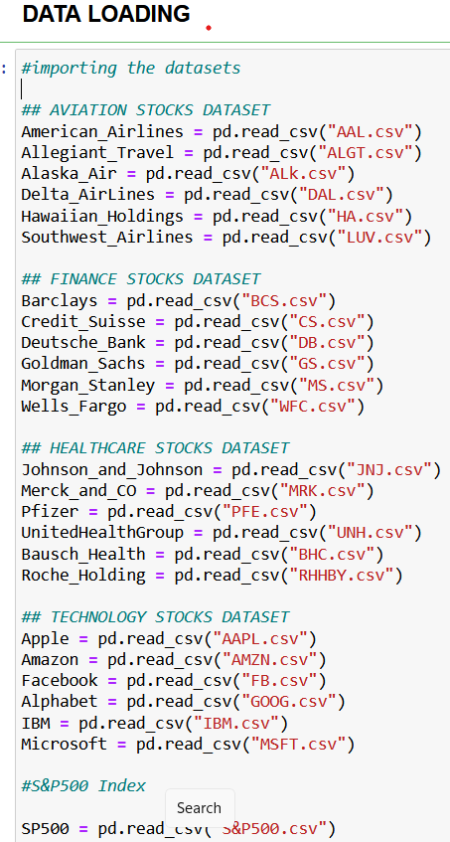
Preliminary Steps - Data loading Data set Data Loading

Slide 6
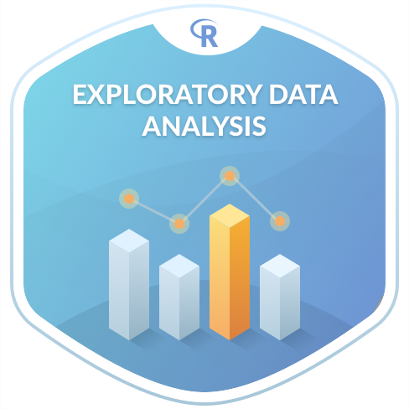
Exploratory Data Analysis

Slide 7
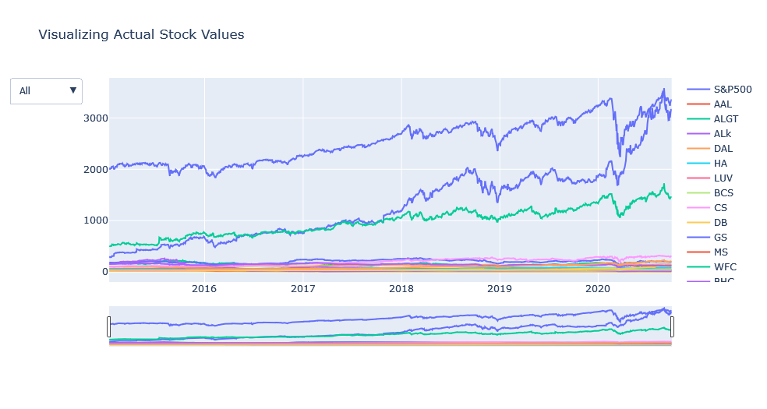
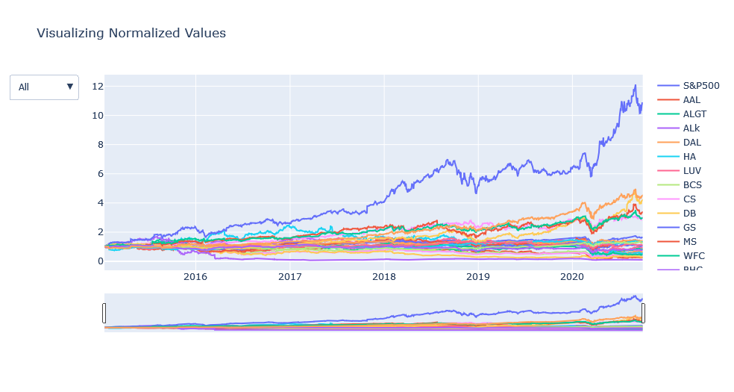
Visualization of Stock Value
Actual Stock Values
Normalized Stock Values
Amazon and Google – Upward Trend
Stocks like Amazon, MSFT, AAPL
which are performing better than S&P500

Slide 8
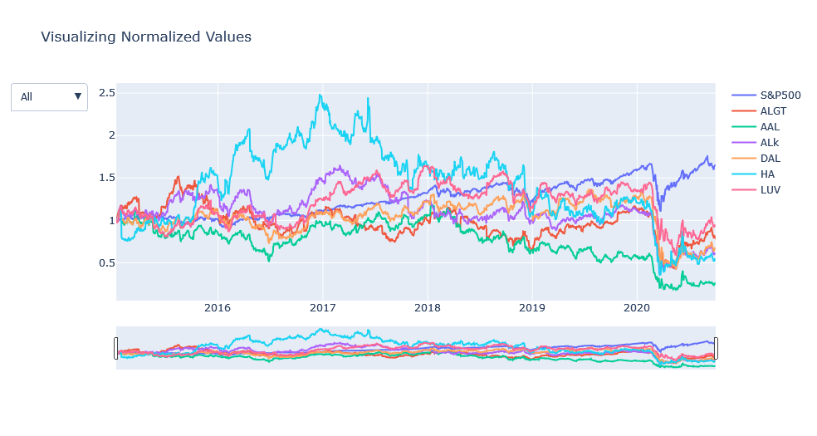
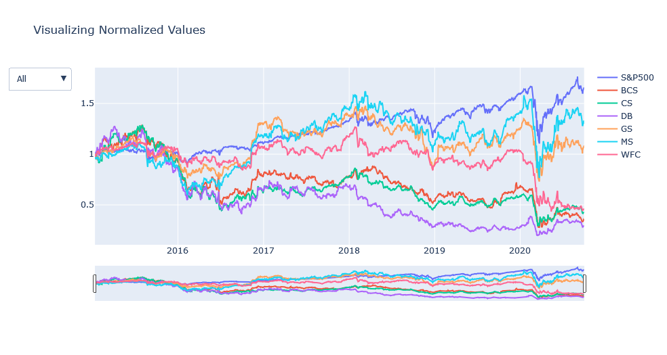
Sector – Wise Analysis
Aviation Sector
Finance Sector
The stocks were constantly good still 2019 but due to Corona Pandemic hit in March 2020 Aviation sector has faced a major crisis and the sector has not recovered there after even thought market index has gone up.
Due to Corona Pandemic hit in March 2020 Finance sector has also faced a major crisis
Morgan Stanley & Goldman Sachs have performed well when compared to other stocks.

Slide 9
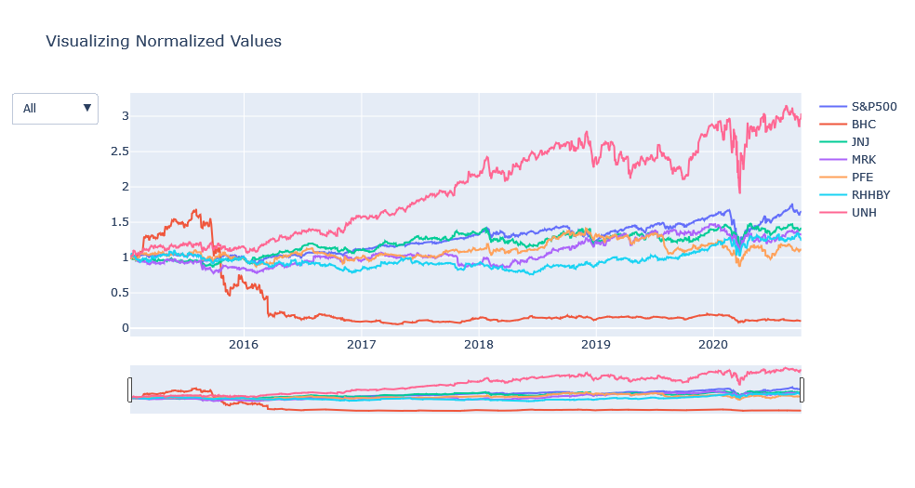
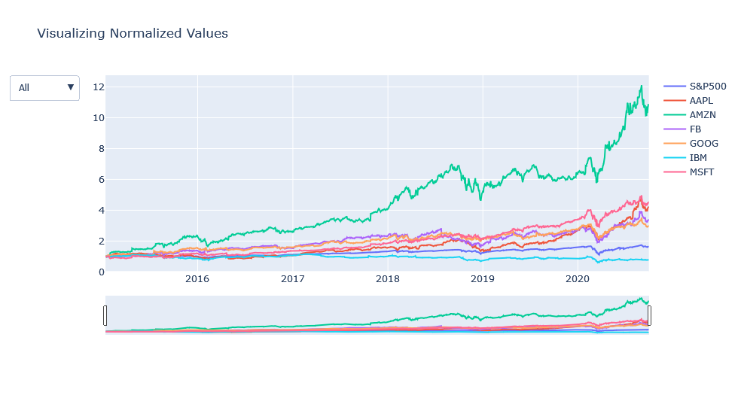
Sector – Wise Analysis
Pharma and Healthcare Sector
Technology Sector
Due to Corona Pandemic hit in March 2020 Pharma & Health care sector has also faced a major crisis and the recovery rate shown by this sector is commendable.
United Health, Johnson & Johnson have performed well when compared to S&P Index.
Bausch Health is consistently performed very badly over the years when compared to other stocks in the same sector.
Due to Covid Pandemic hit in March 2020 Technology Sector has also faced crisis but the recovery rate shown by this sector is commendable.
Microsoft, Amazon, Apple, Facebook & Google have performed well along with Market index.
The stock performed very badly over the years when compared to other stocks in the same sector is IBM

Slide 10
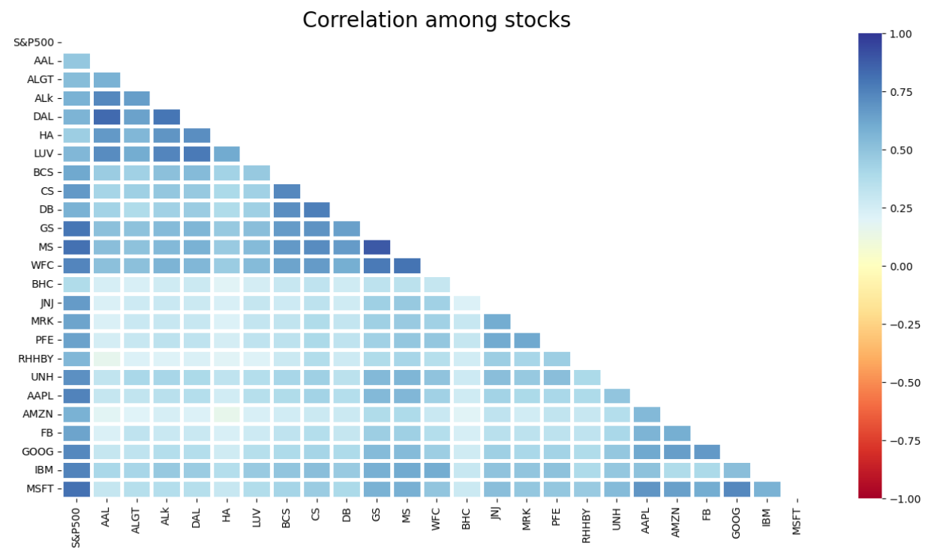
Correlation Among Stocks
American Airlines & Delta Airlines are more correlated than Alaska Air Group in the Aviation sector stocks.
Goldman Sachs, Morgan Stanley & Wells Fargo are correlated in the Finance sector Stocks.
Pharma sector stocks are less correlated when compared to any other sector stocks
Microsoft & Google stocks are highly correlated in the Technology sector Stocks.

Slide 11
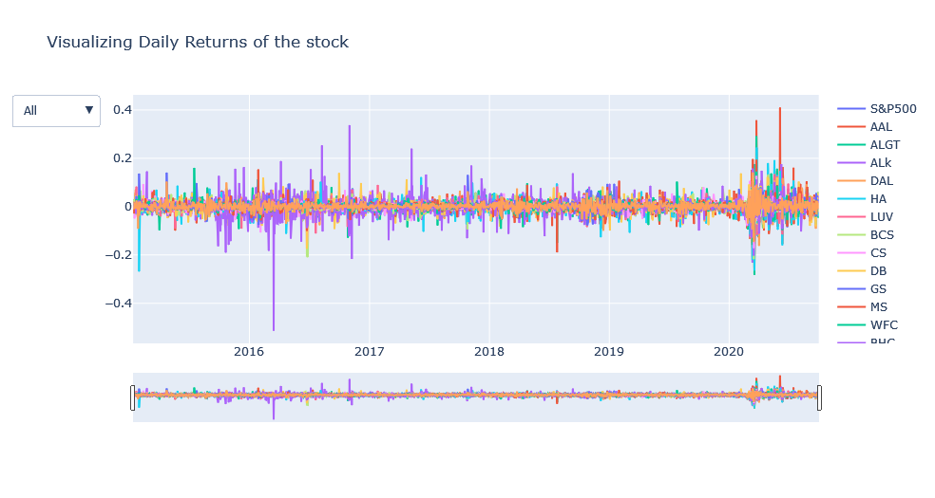
Daily Returns of the stock

Slide 12
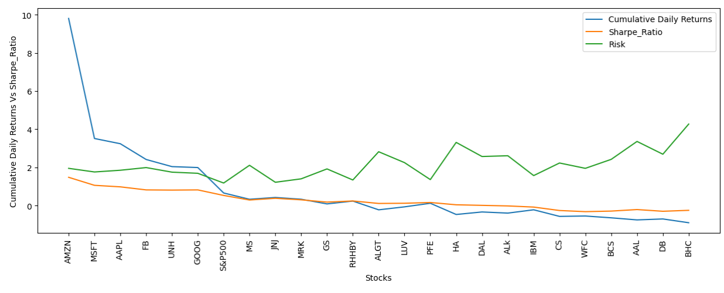
Cumulative Daily returns ,Sharp ratio & Risk

Slide 13
Stocks have good annual returns – End of 5 years
Company | Avg Daily Returns | Risk | Min | Max | Annualized Returns | Annualized Risk | Sharp Ratio | Cumulative Returns
AMZN | 0.18 | 1.95 | -7.92 | 14.13 | 46.4 | 30.9 | 1.48 | 980.52
MSFT | 0.12 | 1.76 | -14.7 | 14.22 | 30.28 | 27.93 | 1.06 | 351.35
AAPL | 0.12 | 1.85 | -12.9 | 11.98 | 29.62 | 29.4 | 0.98 | 324.02
FB | 0.11 | 1.99 | -19 | 15.52 | 26.52 | 31.59 | 0.82 | 241.37
UNH | 0.09 | 1.75 | -17.3 | 12.8 | 23.35 | 27.82 | 0.81 | 204.02
GOOG | 0.09 | 1.69 | -11.1 | 16.05 | 22.78 | 26.9 | 0.82 | 199.18
S&P500 | 0.04 | 1.18 | -12 | 9.38 | 10.62 | 18.75 | 0.53 | 65.81
MS | 0.04 | 2.11 | -15.6 | 19.77 | 10.57 | 33.48 | 0.29 | 32.94
JNJ | 0.03 | 1.22 | -10 | 8 | 8.08 | 19.44 | 0.38 | 42.36
MRK | 0.03 | 1.4 | -8.9 | 10.41 | 7.47 | 22.21 | 0.3 | 33.15

Slide 14
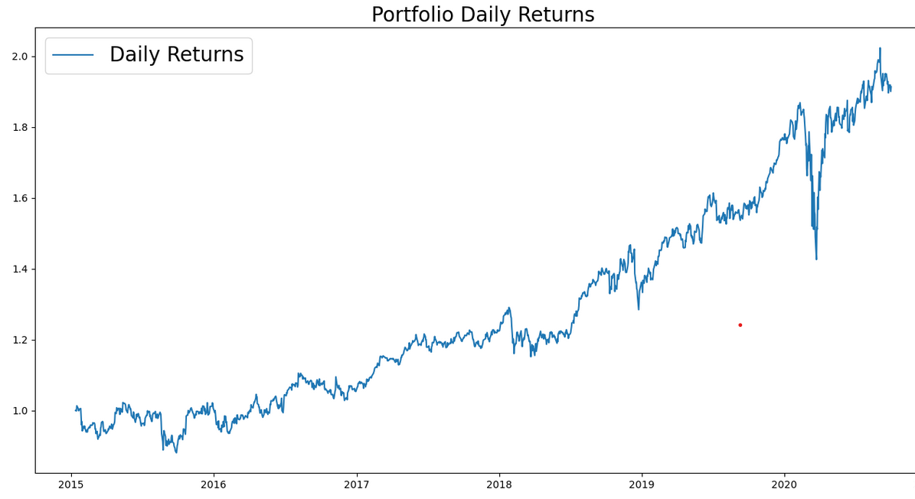
Portfolio Analysis
Patrick Jyengar Portfolio
Mr. Patrick Jyengar wants to double his investment in the span on 5 years. He wants to invest in low risk stocks which would fetch him decent returns.
As per his profile Low risk stocks like JNJ,RHHBY and MRK is suitable to invest on. But overall returns with these three stocks wouldn't reach the target what Mr. Patrick is investing for. So one portion of his wealth can be invested on MSFT to gain the desired returns.
Keeping all the weightage of stocks equal that is 0.25 across all stocks.
Returns that he would fetch after 5 years is 0.95 Million Dollar with 456.92 Thousand dollar of gain on investment.

Slide 15
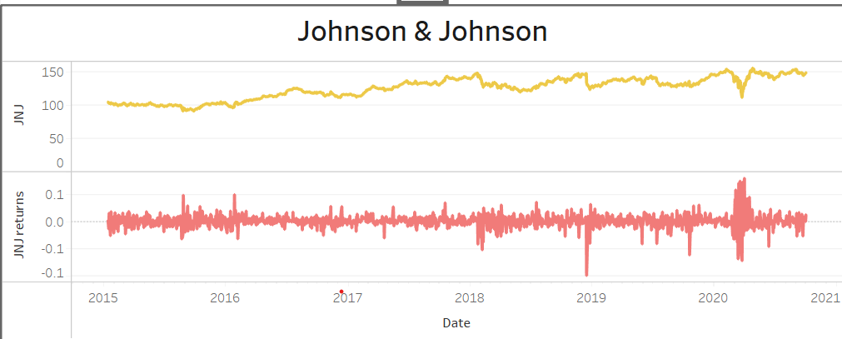
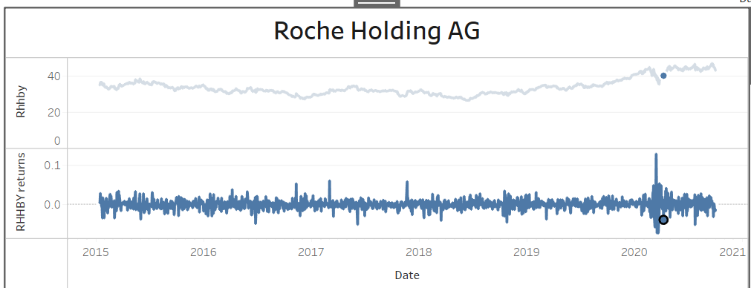
Portfolio Analysis
Patrick Jyengar Portfolio

Slide 16
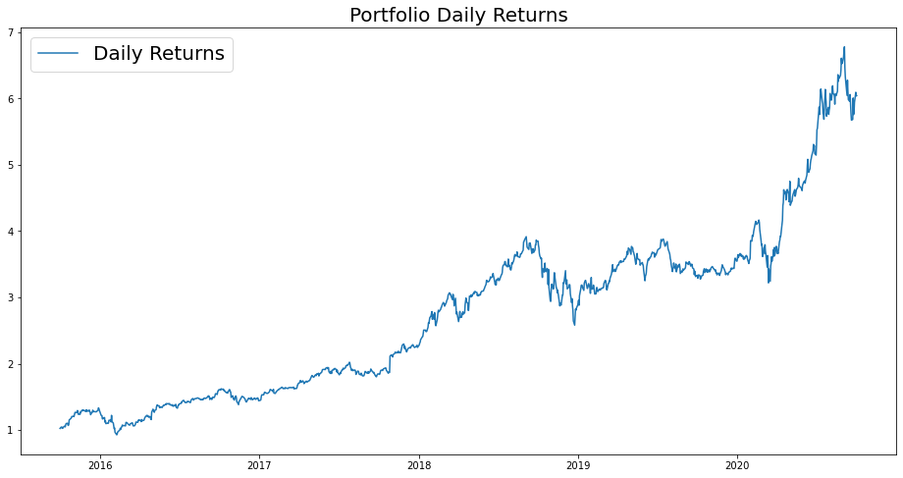
Portfolio Analysis
Peter Jyengar Portfolio
Mr. Peter Jyengar on the other hand Consistent with his attitude towards risk, he prefers high-return investments. Believes that he can still bounce back in case of any occasional losses.
He Wants to invest $1 million from company's cash and cash equivalents in the most high-margin stacks Expects high returns within 5 years for inorganic expansion of his company.
As per his profile High risk/High Returns stocks like AMZN is suitable to invest on.
Overall returns with this stock would fetch him Maximum returns and also cater the Risk. Risk associated with the above mentioned portfolio.
As Mr. Peter jyengar invests 1 Million Dollar on equities i.e. the AMZN stock. Returns that he would fetch after 5 years is more than 10 Million Dollars with 9+ Million dollars of gain on investment.

Slide 17
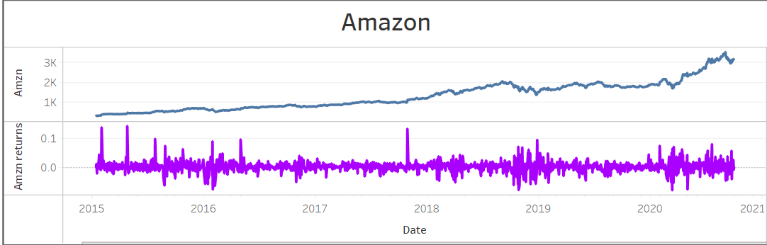
Portfolio Analysis
Peter Jyengar Portfolio

Slide 18
THANK YOU

